Slide 1
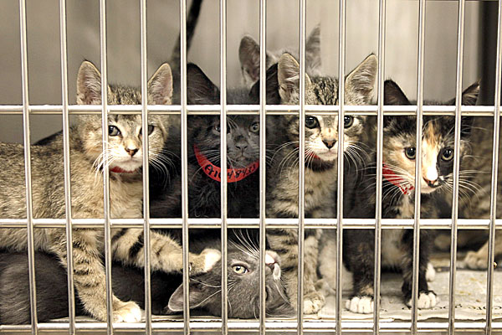
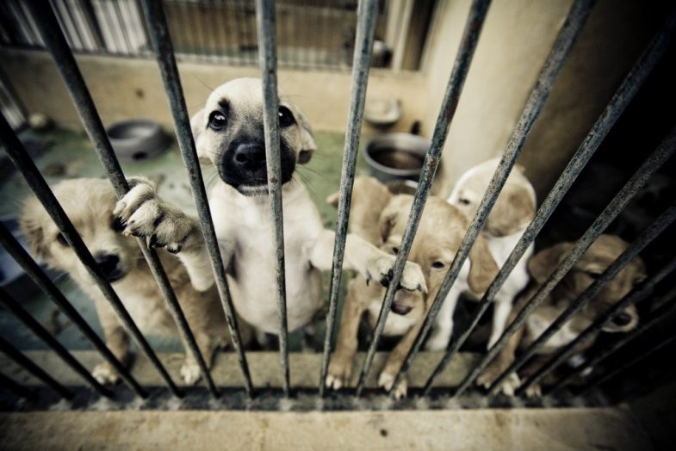
Animal shelter outcome predictions
Sabrina Riebe

Slide 2
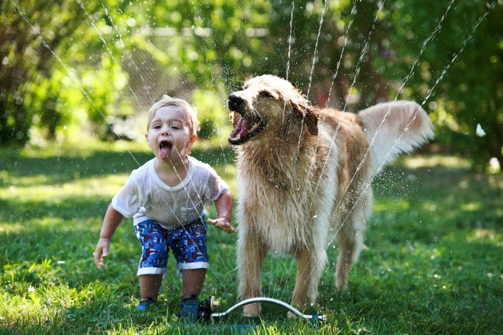
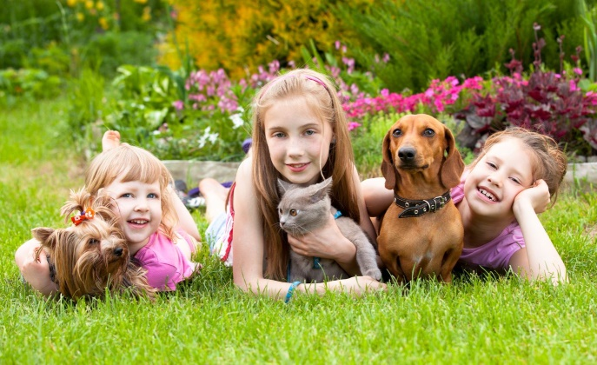
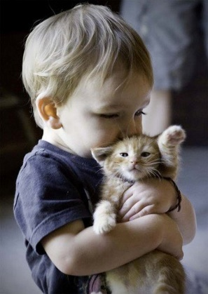
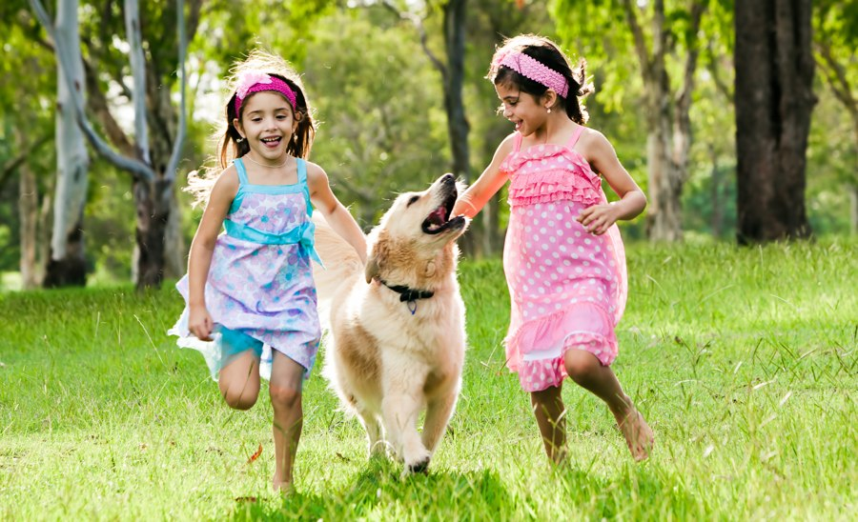
The problem and the goal
7.6 Million shelter animals in the U.S. each year.
2.7 Dogs and cats are euthanized each year in the U.S.
The goal of this project is to create a model to predict trends in animal outcomes.
Purpose: predict whether animals are adopted or not
Benefit: These insights could help shelters focus their attention on those animals that are predicted to need a little extra help finding a new home.

Slide 3
Animal Shelter Dataset
Starting with 10,000 animal profiles
  Approximately 5800 dogs
  Approximately 4100 cats
  Information provided:
  What I plan to extract
    Spayed/Neutered/not
    Date (month) the animal left the shelter
    Numeric age
    Purebred or mixed breed
Animal ID
Date & Time
Outcome
Animal type (cat or dog)
Neutered/spayed/gender
Age
Breed
Color
Name
Outcome subtype

Slide 4
Proposed solution
1) Balanced Prediction Model
  Predict the outcome (Logistic Regression, Decision Tree, Neural Network, Random Forest, XGBoost)
  Ensemble method
  Final prediction
2) Dashboard
  Visual insights into which animals are more likely to be adopted and which not
  Focus attention on those animals predicted to struggle
  Promote adoption at popular adoption times in the past

Slide 5
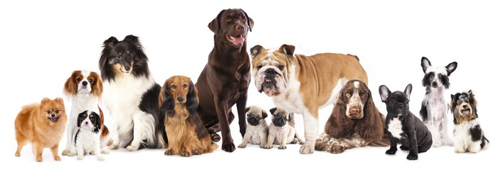
What the model will NOT predict
Outcome: died
  Only 60 records
  Goal is to get animals adopted
    After analysis of original data, <2 and >15 years were only affected
Outcome based on Breed
  I will focus on the age, date, gender, sterilized status
  I will determine whether they are purebred or not

Slide 6
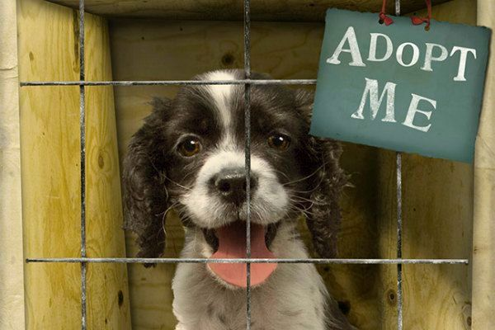
Ethical implications
The dataset is only from 1 shelter in the U.S.
  Counties may be different
  States in the U.S. could also be different
Doesn’t include data about the animal’s health condition
Only dogs and cats; what about the other animals in the shelter
In terms of humans, the data has no ethical implications but could be included for the Animal Shelter

